Slide 1

GSA Digital Service
Joseph Castle
3/23/16

Slide 2
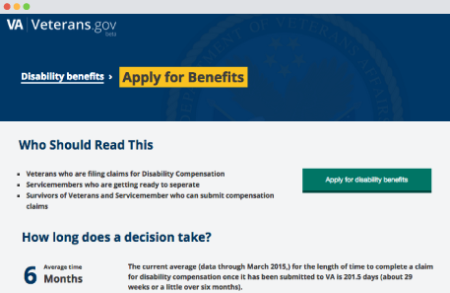
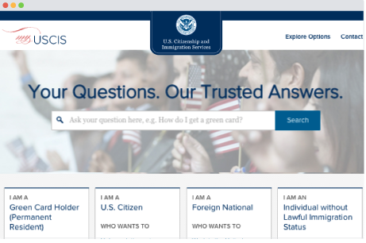
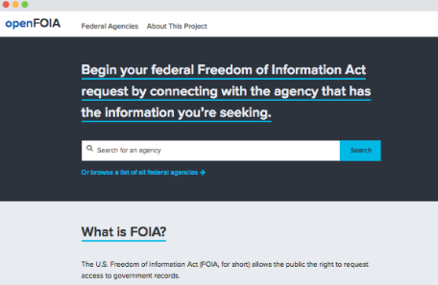
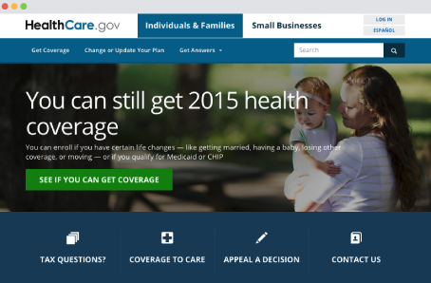
Why GSA DS?
US Digital Service began with Healthcare.gov fix
OMB determined that agencies needed to bring in industry professionals to collaborate with government employees
FY16 Pass Back required all agencies to stand up a digital service team
“Digital services improve when agencies acquire and utilize digital service experts with modern digital product design, software engineering, and product management skills.”
GSA Digital Service team built into GSA IT in FY16

Slide 3
Goals for Delivery
Goal 1: Be the uber GSA IT solution design and development team
Onboard and integrate top industry and government talent for modern solution development
Utilize industry modern design and development tools; support cloud strategy implementation
Goal 2: Utilize Agile methodologies and practices in accordance with the Agile Manifesto
Identify projects and institutionalize new project management methodologies
Work closely with Solutions Engineering and GSA IT teams broadly to implement new solutions
Goal 3: Continuously enhance skills, research new products, and share experiences of new technological tools
Act as the “early adopters” for new technologies that GSA IT may consider implementing
Experiment with SW, HW, and cloud solutions to determine security and policy feasibility for GSA
Goal 4: Promote an open-first and collaborative strategy for all solutions
Develop and execute GSA IT strategies (e.g., Open Data, API, Open Gov, Open Source); support OMB initiatives (e.g., IT Solutions Challenge, Collaborative Work Groups)
Engage data/API consumers through open.gsa.gov and public events (e.g., Hackathons, Design Challenges)

Slide 4
Organizational Structure
Chief Information Officer
Chief Technology Officer
Digital Service Division
Solutions Strategy Division
Project 1
Agile PM/Design/Dev
Project 2
Agile PM/Design/Dev
Project 3
Agile PM/Design/Dev
Project 4
Agile PM/Design/Dev
Contractors
Contractors
Contractors
Contractors

